Slide 1


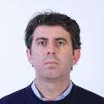
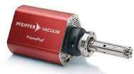
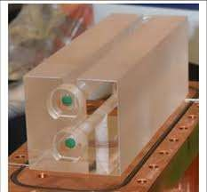
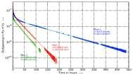
Research group in the field of Nanophysics Outgassing and diffusion measurement
Contact person/Group leader: Prof.Dr. Sefer Avdiaj
Affiliation | Department of Physics, University of Prishtina, Kosovo Mother Teresa av 3. Prishtina 10000, Kosovo sefer.avdiaj@uni-pr.edu;sefer.avdiaj@gmail.com https://fshmn.uni-pr.edu/getattachment/Departamentet/Departamenti05/Personeli-akademik/CV---List-of-publications_Sefer-Avdiaj--.pdf.aspx Msc.Ibrahim Hameli; Msc.Yllka Delija, Msc.Isuf Tredhaku. Bsc.Lyra Hoxha, Zgjim Rrustemi https://scholar.google.com/citations?user=YT0Y55UAAAAJ&hl=en&oi=ao https://www.researchgate.net/profile/Sefer_Avdiaj
Mail address
Email/website Group Members
Google Scholar Research Gate
Research lines
Our research group is working in the field of nanoscience focused in vacuum physics.
We are working in measurement of diffusion and permeation coefficients of different gases (Argon, Helium etc) in different glass materials such as ultra low expansion glass, zerodur and sapphire. The aim of such measurements is to establish a new pressure standard – quantum pascal.
Theoretical calculation and evaluation of edge effect during outgassing measurement. Outgassing measurement of different materials used in vacuum physics.
We are building a static expansion standard used in vacuum metrology as a national
pressure standard.

